Slide 1



Robustness of Real Time deepfakes
Evaluating the robustness of real time deepfakes by implementing avatarify and examining edge cases on it

Slide 2
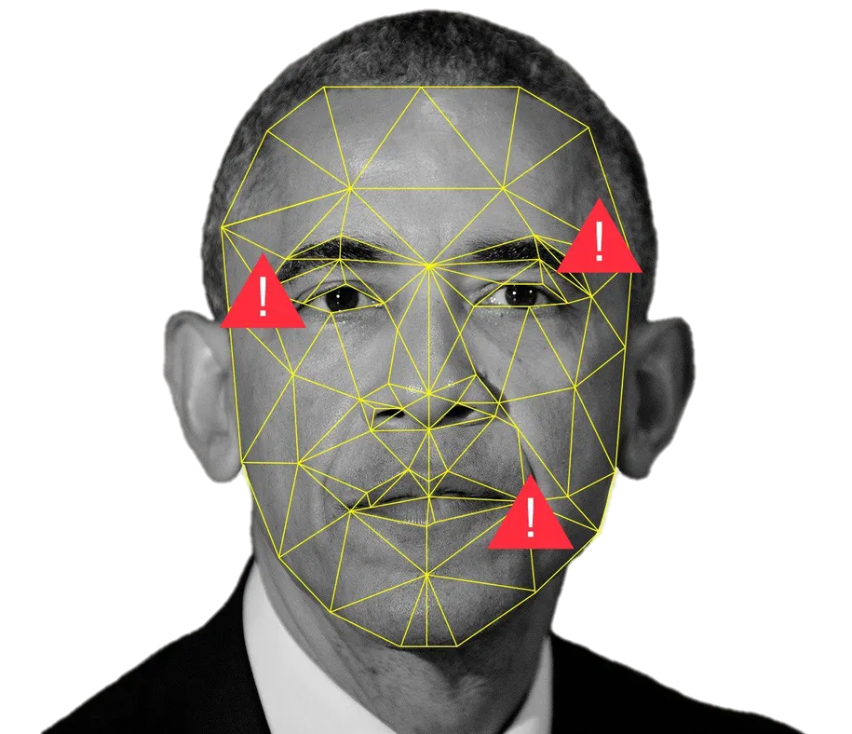
Deepfakes
Deepfake is a general term that encompasses the use of deep learning algorithms in order to create synthetic media, in which one subject in an existing visual and/or audio content is usually replaced with another's likeness. While fraudulent content has been around for some time, recent advances in machine vision have posed a major threat to the trust and transparency of the media. Using powerful machine-learning and deep-learning techniques, deepfakes can now manipulate or generate visual and audio content that can be more easily misleading.
In recent years, deepfakes have garnered widespread attention for their uses in spreading fake news, committing financial fraud, creating pornographic materials, and many other disturbing uses. This has led to a significant need to identify and restrict their use.

Slide 3

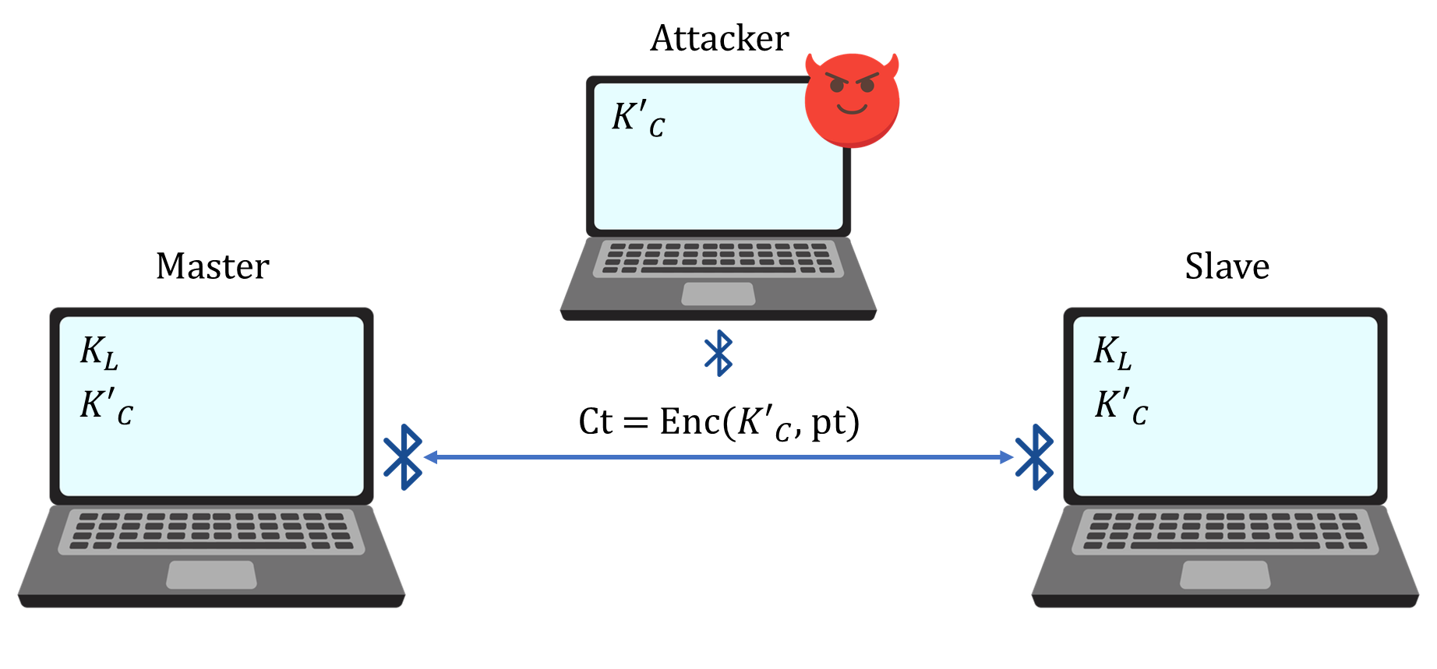


Deepfakes
The victims are paired and initiate a Bluetooth connection
As part of the pairing process, the victims negotiate on the entropy of the encryption key
The attacker makes the victims negotiate an encryption key with 1 byte of entropy
The attacker brute-forces the encryption key in real-time
The attacker decrypts all victims’ messages and injects valid messages
$E_{0}$ or AES-CCM

Slide 4

Thank You

